Slide 1

AMBU
Analyzing Moving Boundaries Using R
AMBUR package for R
Basic User Guide (Windows)
Version 1.0a
Title Analyzing Moving Boundaries Using R
Date 2010-11-01
Author Chester W. Jackson Jr. <jackson.cwjr@gmail.com>
Maintainer Chester W. Jackson Jr. <jackson.cwjr@gmail.com>
Description Tools for analyzing shoreline change and other boundary movements.
Depends R (>=2.11.0), akima, locfit, shapefiles, sp, spatial, spatstat
Suggests forecast
License GPL (>=2)
URL http://r-forge.r-project.org/projects/ambur/
Repository CRAN R-Forge
Requires: shapefiles (non-geographic coordinate system projection)
Date/Publication 2010-11-01
Jackson, C.W., Jr., 2010. Basic User Guide for the AMBUR package for R, version 1.0a. Unpublished.

Slide 2
Table of Contents
R Installation and Setup 3
AMBUR Installation and Setup 9
Starting AMBUR’s GUI (graphical user interface) 15
Preparing Shoreline Shapefiles 17
Preparing Baseline Shapefiles 19
Constructing Transects 21
Filtering Transects 24
Capturing Shoreline Positions Along Transects 28
Shoreline Change Analysis 31
Additional Shapefiles with Analysis Results 38
Extrapolate Future/Past Shoreline Positions 42

Slide 3
R Installation and Setup

Slide 4
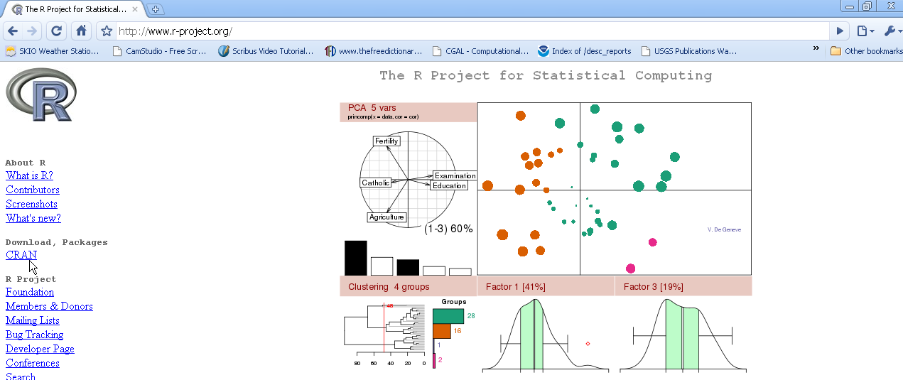
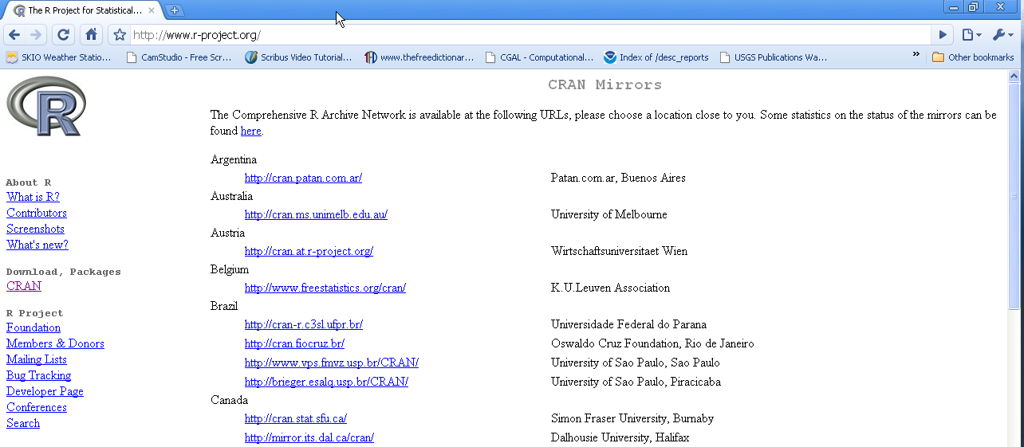
R Installation and Setup
Step 1
Download R from http://www.r-project.org website by first selecting the CRAN link under 'Download, Packages'
Step 2
Select a mirror (location) that you wish to download R from. Some mirrors might be faster than others.

Slide 5
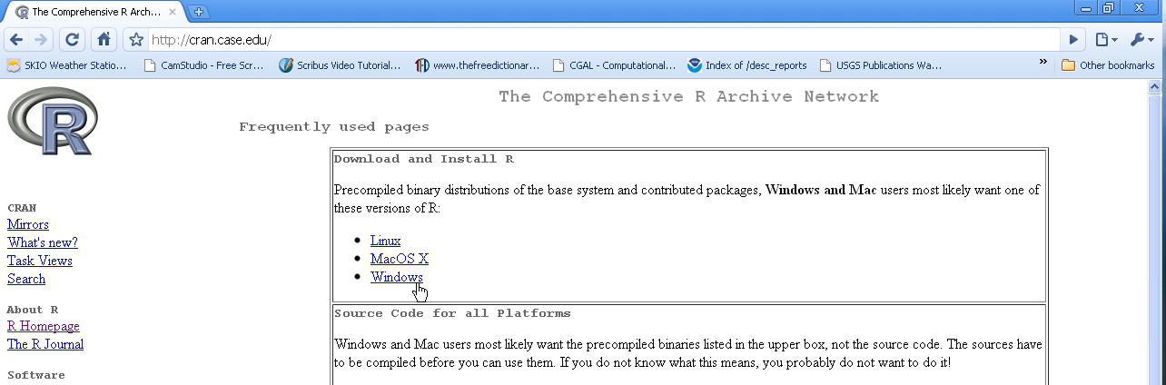
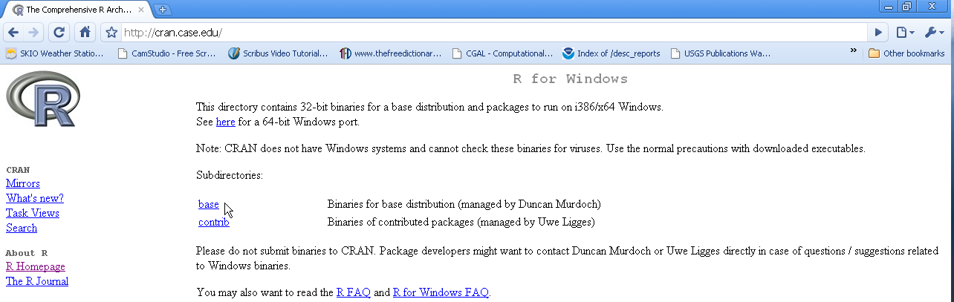
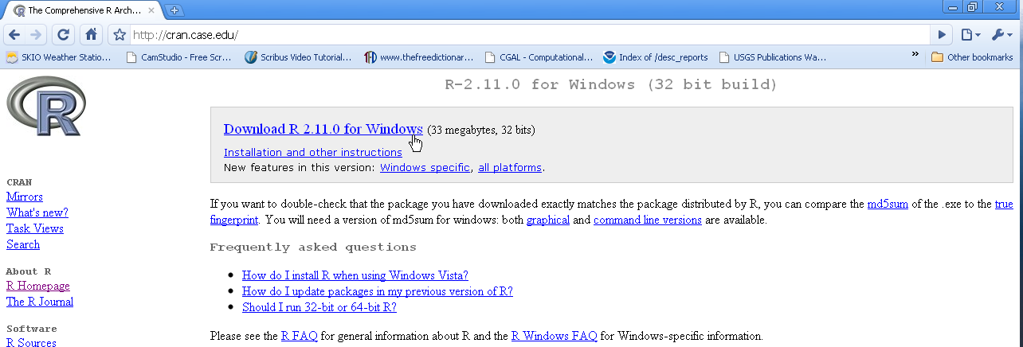
R Installation and Setup
Step 3
Click on the ‘Windows’ link to access the Windows versions of R’s installation files
Step 4
Click on the ‘base’ link to access the base R installation file
Step 5
Click on the link for the R installer to download the file
TIP: R provides additional links for installation instructions here.

Slide 6
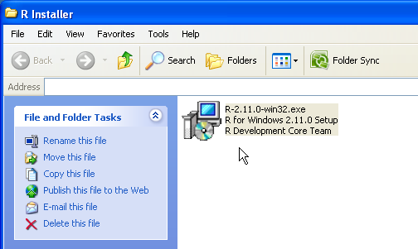
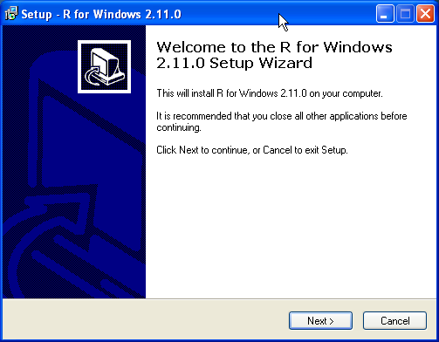
R Installation and Setup
Step 6
Double-click the R installer file and install R.
TIP: It is okay to accept all of the default parameters during the installation process.

Slide 7
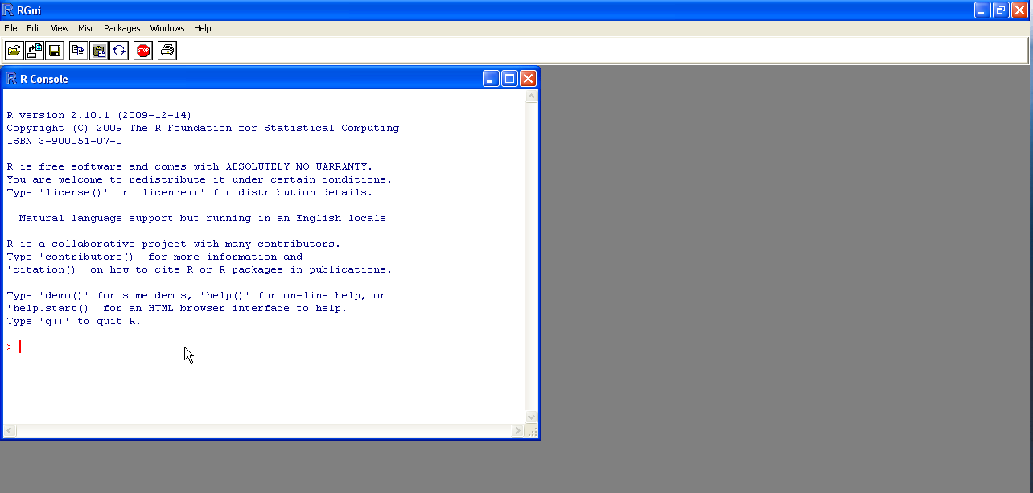
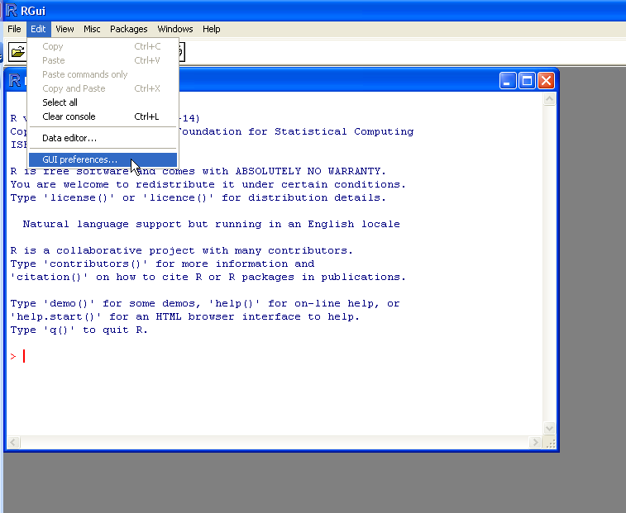
R Installation and Setup
Step 7
Open the R program. The default is set to run R in ‘MDI’ mode as shown below. However, it is preferred to run R in ‘SDI’ mode for increased stability.
Step 8
Setup R to run in ‘SDI’ mode by choosing “GUI preferences” under the ‘Edit’ menu.

Slide 8
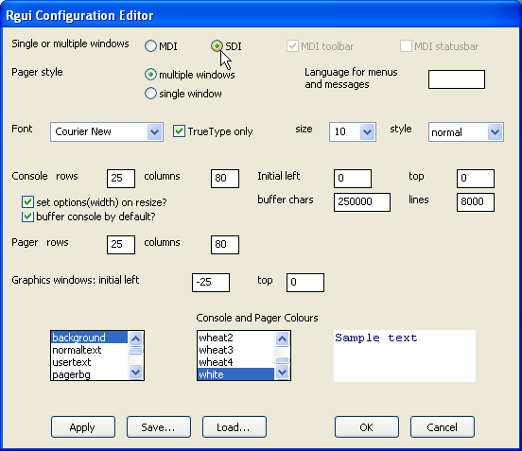
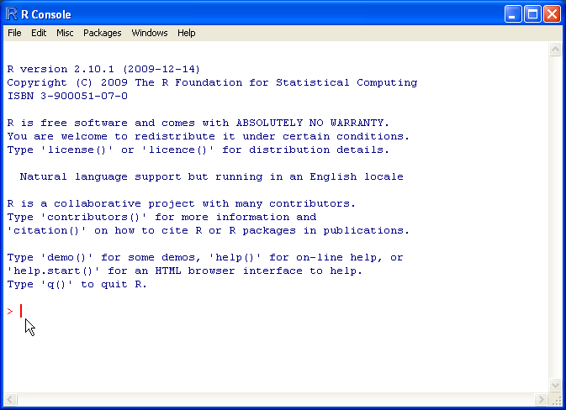
R Installation and Setup
Step 8 (continued)
Select the ‘SDI’ mode radio button and then click the “Save” button to save a “Rconsole” preference file on your computer. You may save this preference file in your My Documents folder. Finally, click “OK”.
1
2
3
After saving the preference file, close R and do not save the workspace image when prompted to. Restart the R program. It should now be running and ‘SDI’ mode and only show the R Console window and command prompt such as below:

Slide 9
AMBUR Installation and Setup

Slide 10
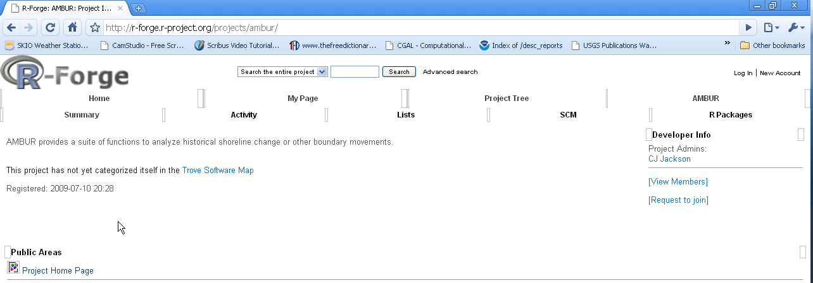
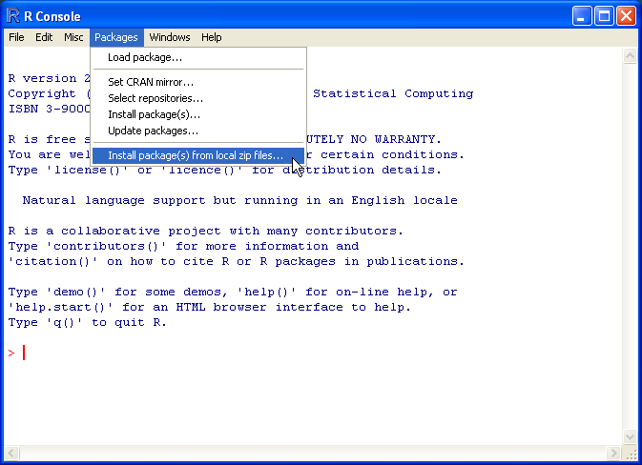
AMBUR Installation and Setup
Step 1
Download the AMBUR package from http://r-forge.r-project.org/projects/ambur/
website. The package is a *zip file that will be loaded by R during the initial installation process.
Step 2
Install AMBUR file by choosing ‘Install package(s) from local zip files…’ under the ‘Packages’ menu. Select the AMBUR *zip file that was downloaded to your computer.

Slide 11
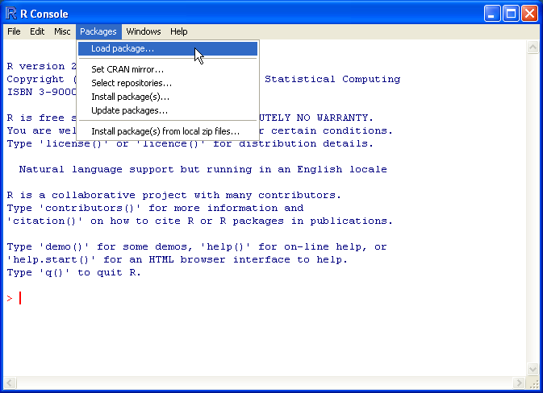
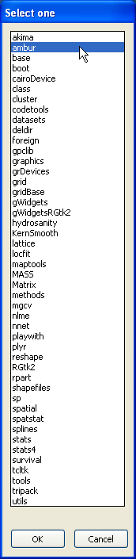
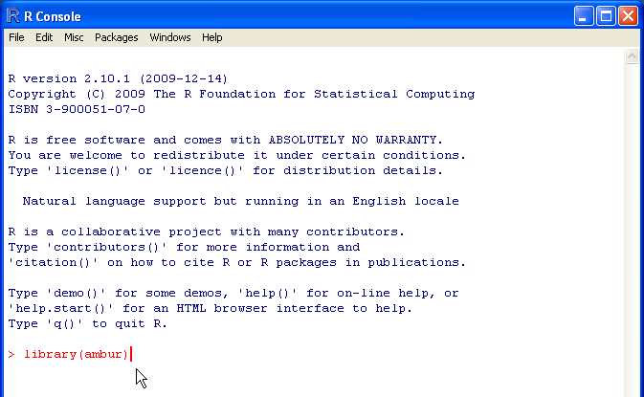
AMBUR Installation and Setup
Step 3
Load the AMBUR package to begin analyses by choosing ‘Load package…’ under the ‘Packages’ menu. Select AMBUR from the list. NOTE: AMBUR must be manually loaded every time R is started.
Step 3 (alternative)
Load the AMBUR package to begin analyses by typing: library(ambur) at the command prompt and pressing the Enter key. The cursor will move to the next line below.
TIP: Once AMBUR is loaded, it will automatically load other required packages.

Slide 12
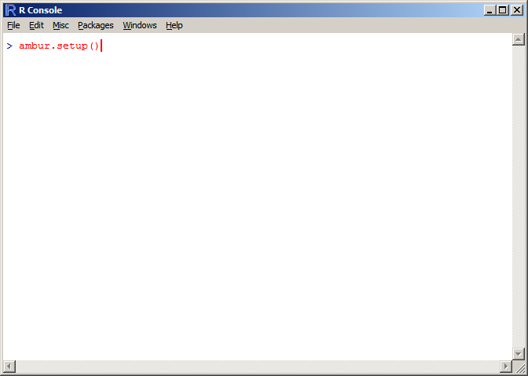
AMBUR Installation and Setup
Step 4
Install additional required R packages to run AMBUR by typing: ambur.setup( ) at the command prompt. Note: you must be connected to the internet for this step.
AMBUR will begin installing the following required packages: akima, locfit, shapefiles, sp, spatial, & spatstat. Be sure to verify each package is present in R by choosing ‘Load package…’ under the ‘Packages’ menu making sure each is included in the list. Otherwise you will need to manually install the packages using the instructions on the next page.

Slide 13
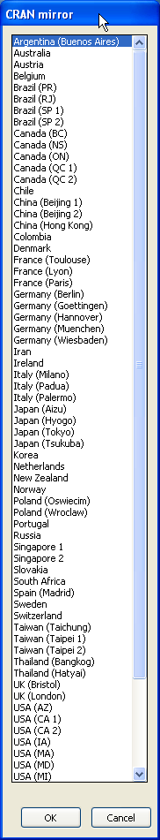
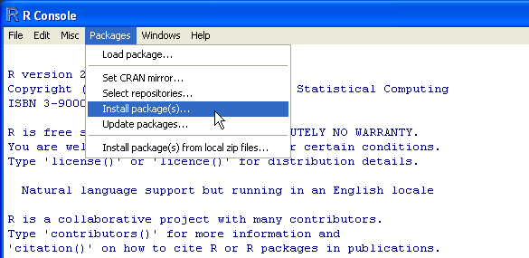
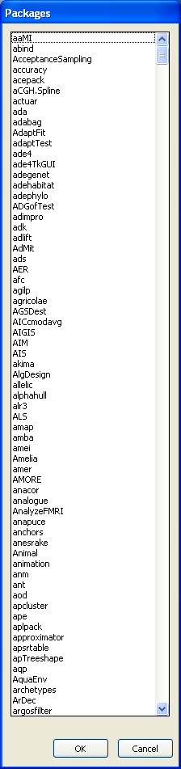
AMBUR Installation and Setup
Manual installation of additional required R packages for AMBUR
Step 1 (if auto installation with ambur.setup( ) fails)
Install additional packages required by AMBUR by choosing ‘Install package(s)’ under the ‘Packages’ menu. Choose any ‘CRAN mirror’ to download the files and click “OK”.
Step 2
Install the following AMBUR required packages: akima, locfit, shapefiles, sp, spatial, & spatstat by selecting them from the Packages’ list and click “OK” at the bottom window. Multiple selections are permitted to download more than one package at a time.

Slide 14
AMBUR Installation and Setup
Step 3
Load the AMBUR package to begin analyses by choosing ‘Load package…’ under the ‘Packages’ menu. Select AMBUR from the list. NOTE: AMBUR must be manually loaded every time R is started.
Step 3 (alternative)
Load the AMBUR package to begin analyses by typing: library(ambur) at the command prompt and pressing the Enter key. The cursor will move to the next line below.
TIP: Once AMBUR is loaded, it will automatically load other required packages.

Slide 15
Starting AMBUR’s GUI (graphical user interface)

Slide 16
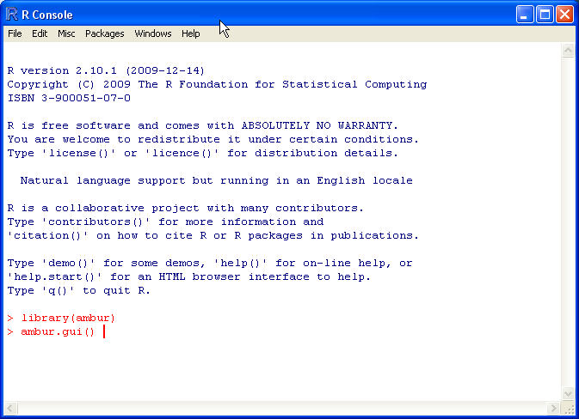
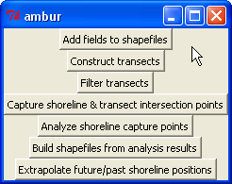
Starting AMBUR’s GUI (graphical user interface)
Step 1
After loading AMBUR package, type: ambur.gui() at the command prompt and press ‘Enter’ to initialize the grapical user interface containing the analysis funtions.
After the ‘Enter’ key is pressed, the AMBUR GUI will appear:

Slide 17
Preparing Shoreline Shapefiles

Slide 18

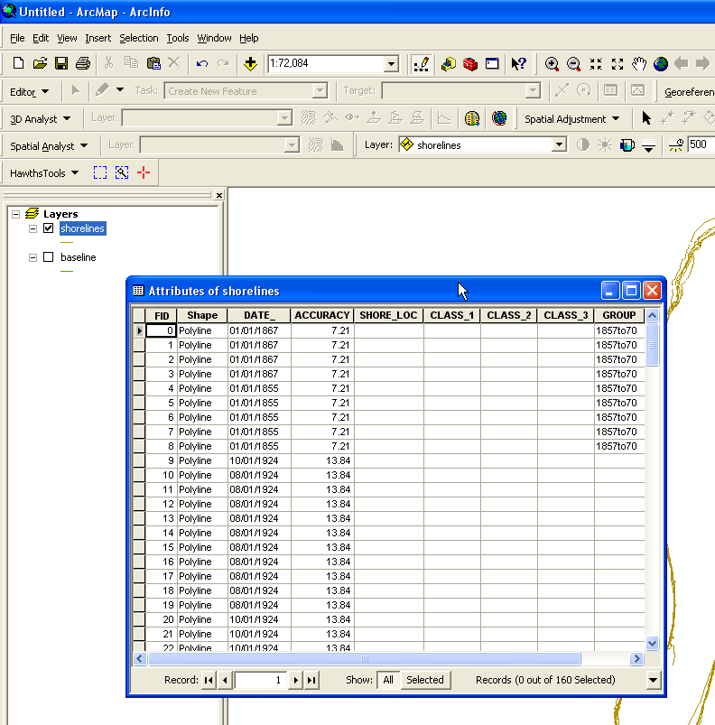
Preparing Shoreline Shapefiles
Shorelines
1. Digitize shorelines in GIS and combine them into one ESRI shapefile
2. Setup the required fields in the attribute table using “Add fields to shapefiles” button on
the AMBUR GUI and enter ‘1’ to create shoreline shapefile fields:
You will be prompted to select the *.dbf file of your shoreline shapefile
3. Populate the attributes in GIS for new fields
-DATE_ field must be in mm/dd/yyyy hh:mm:ss PM format*
-ACCURACY field must be greater than zero and should be the estimated error in map units of shoreline
position error
*Example ‘DATE_’ attribute: 01/01/2010 12:51:00 PM
Example attribute table in ArcGIS for shorelines.
NOTE: Shutdown ArcGIS before adding fields to shapefiles

Slide 19
Preparing Baseline Shapefiles

Slide 20

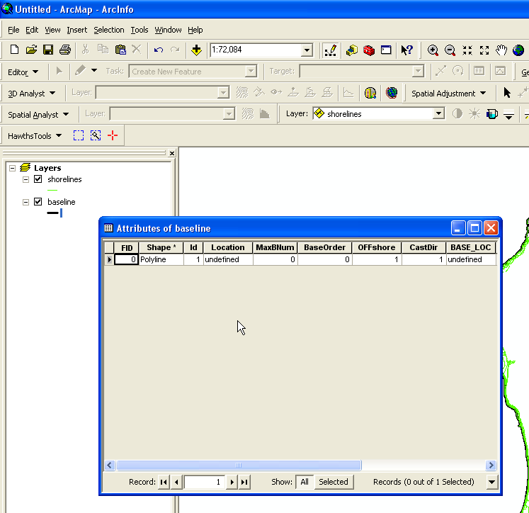
Preparing Baseline Shapefiles
Baselines
1. Digitize baseline(s) in GIS
2. Setup the required fields in the attribute table using “Add fields to shapefiles” button.
Enter ‘2’ to create baseline fields in the attribute table.
3. Populate the attributes in GIS to define baseline’s transect casting order and direction:
-BaseOrder field should be a value of 1 or higher to assign the order which transects are drawn if multiple baselines are present
-Offshore field should be a value of 1 for yes if the baseline is drawn offshore and -1 for no (onshore)
-CastDir field should be a value of -1 to cast transects to the left of the direction of the polyline and 1 to cast transects to the right of the polyline’s direction.
polyline direction
CastDir = -1
transect
polyline direction
Example attribute table in ArcGIS for baselines.
transect
CastDir = 1
NOTE: Shutdown ArcGIS before adding fields to shapefiles

Slide 21
Constructing Transects

Slide 22
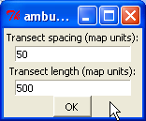
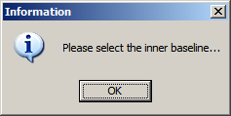
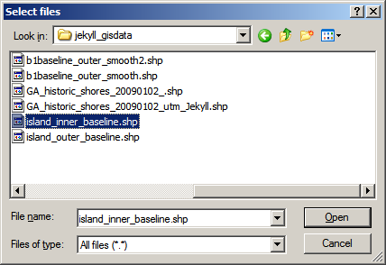
Constructing Transects
Perpendicular, Trimmed, & Near Transects
AMBUR provides support for single baseline casting of perpendicular transects and double
baseline casting of ‘near’ and trimmed perpendicular transects. In the case of double baselines,
one baseline is located onshore (inner) and the other is located offshore (outer) of the historical
shorelines. It is up to the user to determine which baseline will be inner and the outer part of the shoreline change envelope. Transects will be casted along the outer baseline and extend to the inner baseline.
Three transect shapefiles are created:
1. perpendicular transects – traditional transects with a user defined spacing and length
2. trimmed perpendicular transects – perpendicular transects with their lengths confined
between 2 baselines
3. near transects – transects that extend from the outer baseline to the nearest point on the
inner baseline.
Step 1
Select the “Construct transects” button and enter a distance (in map units) for the spacing
between transects along the baseline and their length. Click “OK”.
Step 2
You will be prompted to select an inner baseline shapefile and then an outer baseline shapefile.
If you only have one baseline shapefile, select it as both the inner and outer baseline shapefile.
In the case of a single baseline shapefile, only perpendicular transects will be cast.

Slide 23
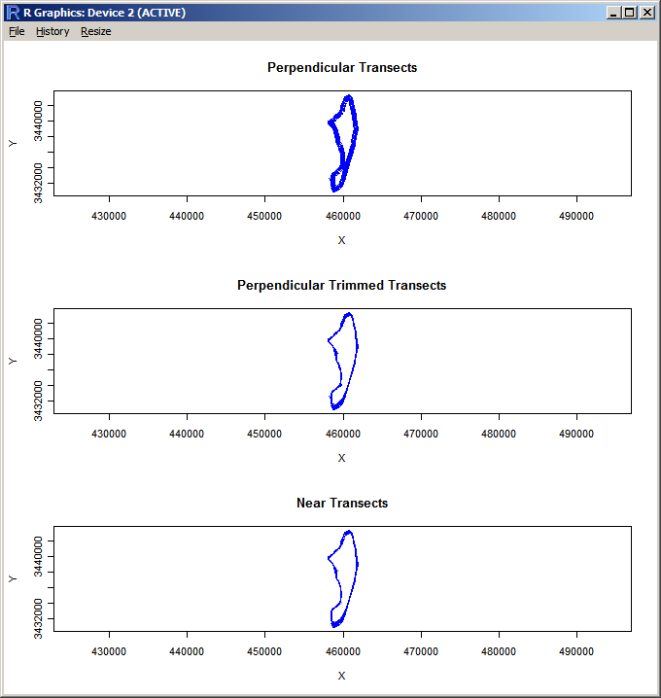
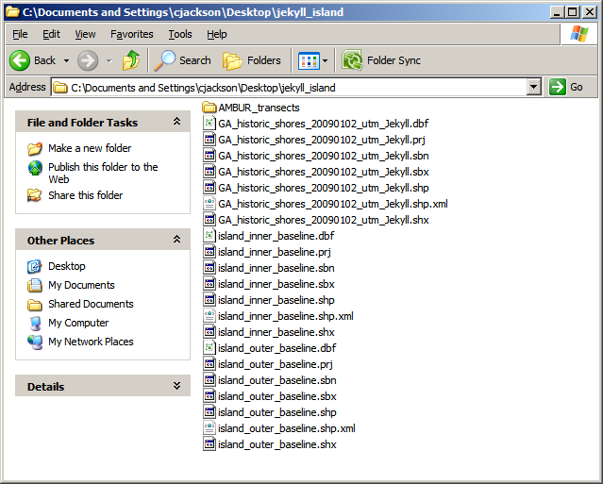
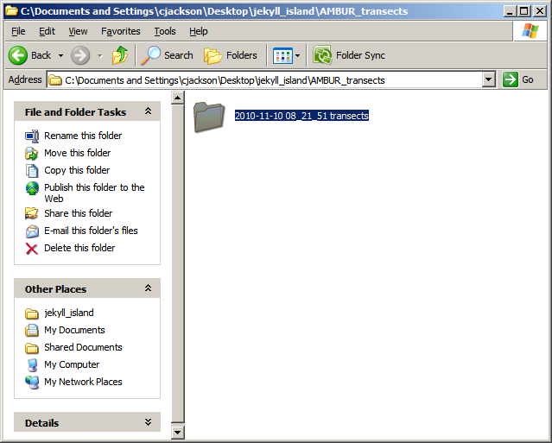
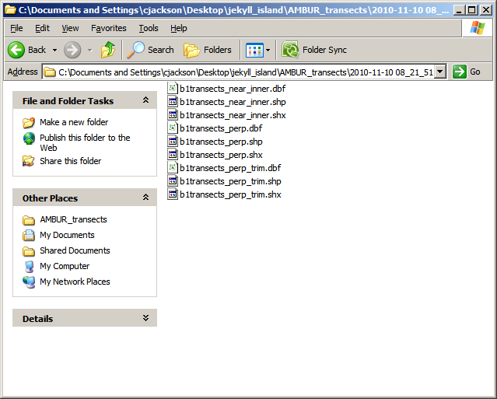
Constructing Transects
Step 2 (continued)
Once the inner and outer baselines are selected AMBUR will cast transects from the “outer” baseline to the inner baseline shapefile. It is important that the shapefile that is chosen to be the outer baseline be properly attributed. AMBUR will then display the results of the transect casting in a window:
AMBUR will also create a date and time stamped folder in a directory named “AMBUR_transects” that is located in the same folder as the baseline shapefiles. This date and time stamped folder will contain the transect shapefiles.

Slide 24
Filtering Transects

Slide 25
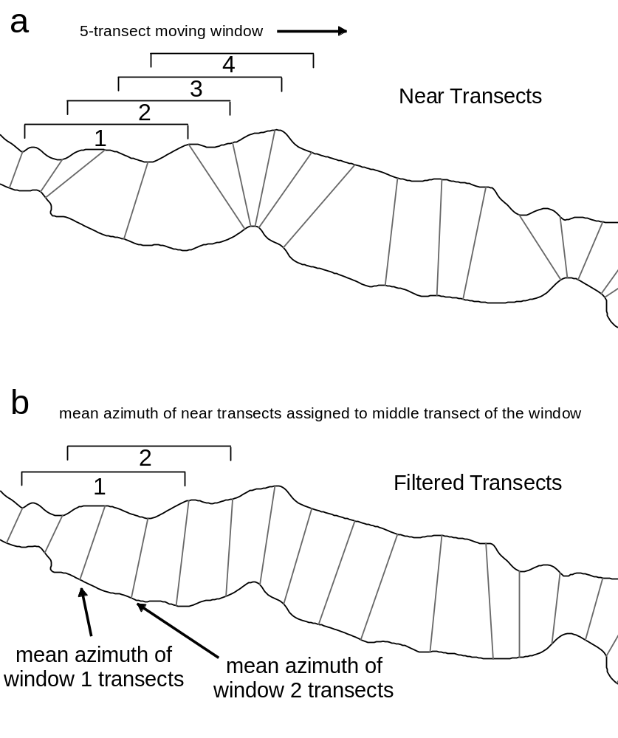
Filtering Transects
Filtered Transects (optional)
Once transects are cast using the “Construct transects” tool, the user may elect to filter or “smooth” transects orientations. For best results, the “near” transects shapefile should be used for filtering. Filtering will assist with reducing gaps between the endpoints of transects and better approximate the curvature of the baselines of the shoreline envelope. Filtering works by taking a moving window average of transect azimuths and assigning the average orientation to the middle transect of the window. Therefore, the user must choose an odd number for the window size.
outer baseline
inner baseline

Slide 26
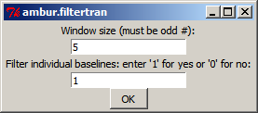
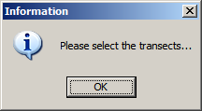
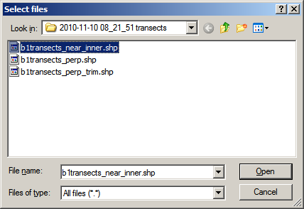
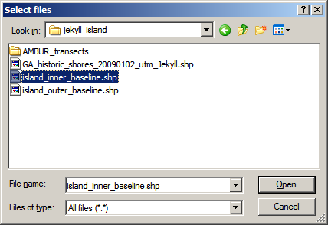
Filtering Transects
Step 1
Select the “Filter transects” button from the ambur gui and enter a window size that equals the number of transects you wish to average. If the original transects were generated from multiple polyline baselines within the outer baseline shapefile, then the filter window will only average transects within each polyline. If you wish the filter window to include transects of adjacent polyline baselines, then set “Filter individual baselines” to “0”. Click “OK”.
Step 2
AMBUR will prompt you to select the transect shapefile you wish to filter. Then select the “inner” baseline shapefile to complete the filtering process.

Slide 27
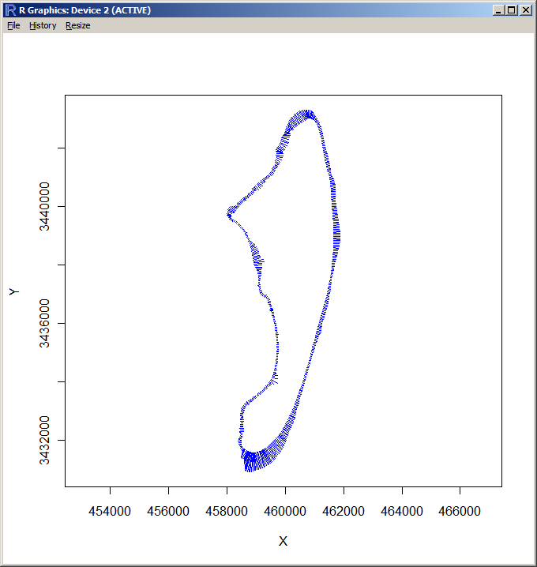
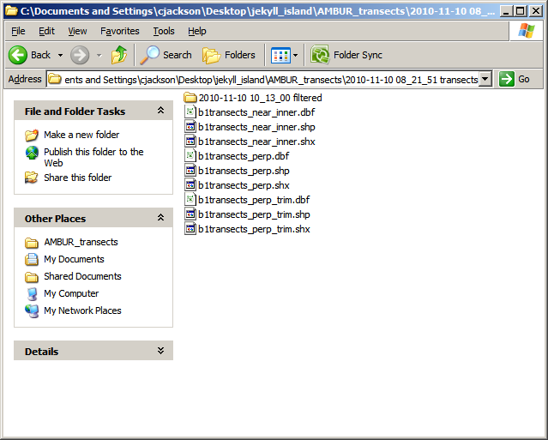
Filtering Transects
Step 2 (continued)
Once filtering is complete, AMBUR will display the results in window and store the results in a date and time stamped folder in the folder that contains the original transects.

Slide 28
Capturing Shoreline Positions Along Transects

Slide 29
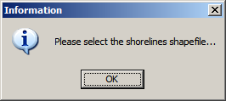
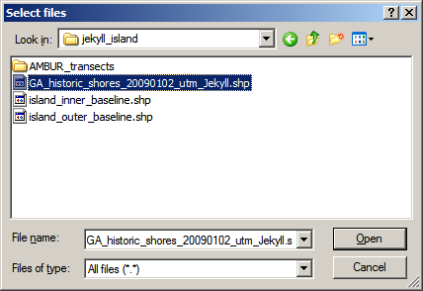

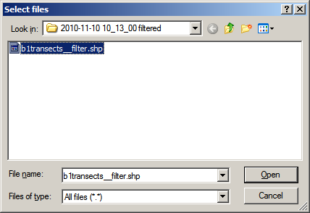
Capturing Shoreline Positions Along Transects
Capturing Historical Shoreline Position Points Along Transects
In order to start a shoreline change analysis, AMBUR must first capture the positions of each historical shoreline along each transect.
Step 1
Select the “Capture shoreline & intersection points” button and select the shoreline shapefile. Click “OK”.

Slide 30
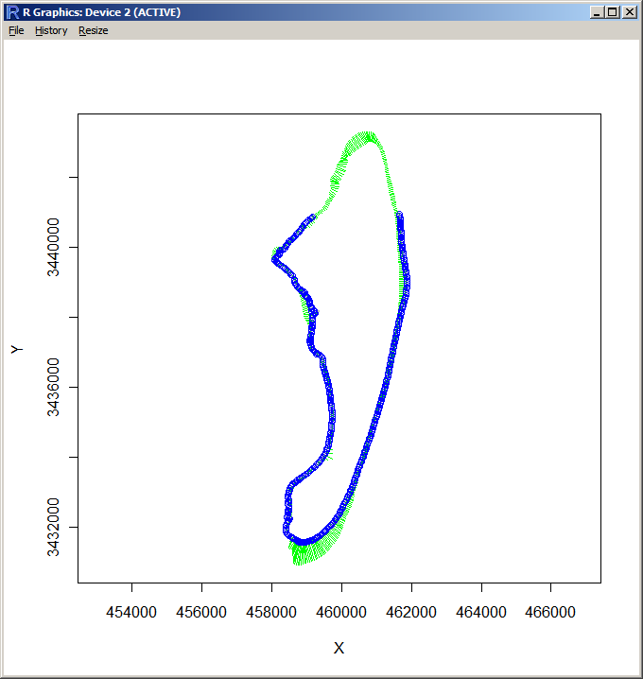
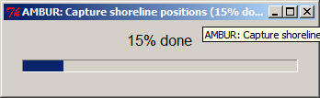
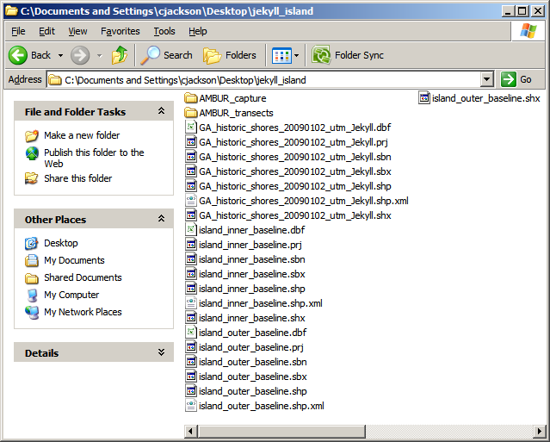
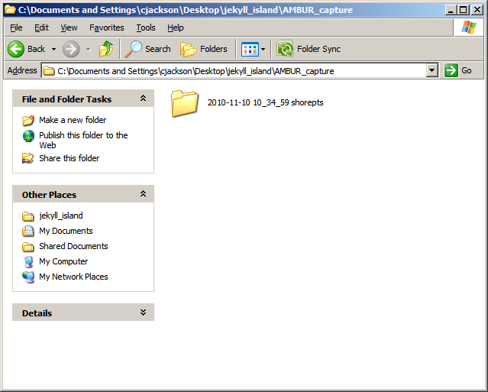
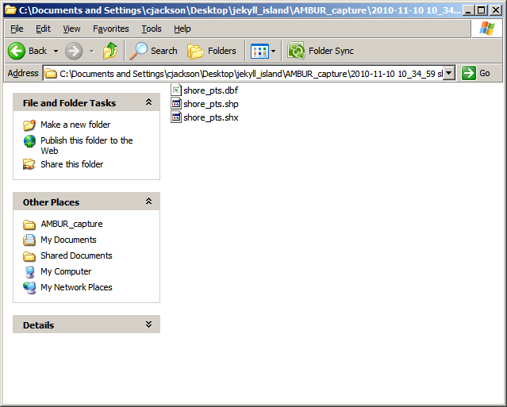
Capturing Shoreline Positions Along Transects
Once the historical shorelines and transects shapefiles are selected, AMBUR will display a status window showing each shoreline segment being intersected with transects. When AMBUR is finished collecting intersection points, it will store them as a point shapefile in a date and time stamped folder in a folder named “AMBUR_capture” in the folder that contains the shoreline shapefile.

Slide 31
Shoreline Change Analysis

Slide 32
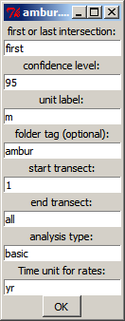
Shoreline Change Analysis
Analyzing Historical Shoreline Positions
Once a point shapefile is built containing historical shoreline positions along transects, AMBUR will measure changes that occur along each transect and generate tabular and graphical data containing the results.
Step 1
Select “Analyze shoreline capture points” from the ambur gui and then you will be prompted to choose the analysis parameters.
Analysis parameters are described on the next page.

Slide 33
Shoreline Change Analysis
Analysis Parameters:
first or last intersection
If a transect intersects the same shoreline multiple times, then by default it will take the first intersection it makes extending from the outer baseline. Enter “last” to take the last intersection point encountered by the transect.
confidence level
Enter the confidence level calculated for linear regression statistics. This is also used to calculate the error bars in the output graphics of the linear regression statistics.
unit label
Enter the units of measure for the map units of the shapefiles. This is used for the graphical output. The default is set for meters for shapefiles with UTM coordinates. Note: this is just for labeling plots only.
folder tag
Optional. Enter text here that you would like to include at the end of the name of the analysis output folder. The default is set to add the name “ambur” at the end of the folder name.
start transect
Enter the transect number where you wish to start the analysis.
end transect
Enter the transect number where you wish to end the analysis.
analysis type
The default is set to “basic”. Enter “advanced” for additional statistics that include a robust linear regression. Note: advanced analysis may take longer to process.
Time unit for rates
The default is set to “yr” for years for calculating rates of shoreline change.
Enter:
“day” for days
“hr” for hours
“min” for minutes
“sec” for seconds

Slide 34
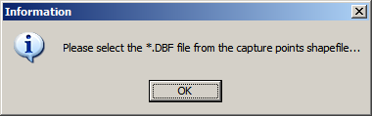
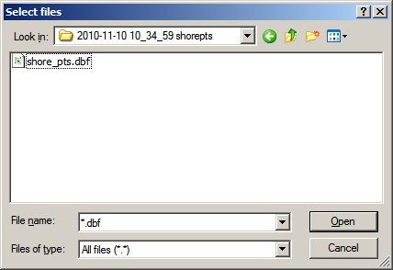
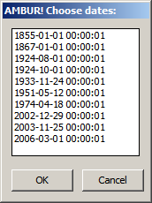
Shoreline Change Analysis
Step 1 (continued)
After you have chosen the analysis parameters click “OK”. You will be prompted to select the *.DBF file of the points shapefile with the historical shoreline position points (located in the “AMBUR_capture” folder).
Step 2
AMBUR will prompt you to choose 2 or more dates to include in the analysis. You must select a minimum of 2 dates.

Slide 35




Shoreline Change Analysis
Step 2 (continued)
AMBUR will generate a status menu and map displaying the analyses being performed along the shoreline at each transect. When finished, a date and time stamped folder is created in a folder named “AMBUR_results” in the folder containing the historical shoreline position points (located in the “AMBUR_capture” folder)

Slide 36
Shoreline Change Analysis
Step 2 (continued)
The folder containing the analysis results has tabular and graphical data. The graphical data are stored as PDF files in the folder named “PDF” and are vector format. There is also a summery report located in the PDF folder with an overview of the analysis results. The “results_stats.csv” and “GIS_stats_table_short.csv” are the two main data files that are focus of this manual and described on the following page. Data files starting with “raw” contain basic shoreline change distances and EPR rates between all possible combinations of shorelines or consecutive eras. Data files starting with “Class” contain the shoreline classification present at each transect (“raw) and change detection of shoreline classifications between consecutive eras (“change”).
The fields in “results_stats.csv” and “GIS_stats_table_short.csv” are described on the following page.

Slide 37
results_stats.csv | GIS_stats_table_short.csv | Description
Transect | Transect | Transect number
Baseline.Offshore | Base_Off | Baseline location: 1 = offshore and -1 = onshore
Transect.Spacing | Tran_Spac | Spacing distance between transects along the baseline
Transect.Distance | Tran_Dist | Length or reach of the transect
Transect.Flag | Tran_Flag | "FLAG" values mean that the transect does not have all dates in the database present
Transect.StartX | Start_X | Starting X coordinate of the transect
Transect.StartY | Start_Y | Starting Y coordinate of the transect
Transect.EndX | End_X | Ending X coordinate of the transect
Transect.EndY | End_Y | Ending Y coordinate of the transect
Transect.Inner.Xcoord | Inner_X | Inner X coordinate of the shoreline change envelope
Transect.Inner.Ycoord | Inner_Y | Inner X coordinate of the shoreline change envelope
Transect.Outer.Xcoord | Outer_X | Outer X coordinate of the shoreline change envelope
Transect.Outer.Ycoord | Outer_Y | Outer Y coordinate of the shoreline change envelope
Min.Date.Xcoord | Min_DateX | Oldest shoreline X coordinate
Min.Date.Ycoord | Min_DateY | Oldest shoreline Y coordinate
Max.Date.Xcoord | Max_DateX | Youngest shoreline X coordinate
Max.Date.Ycoord | Max_DateY | Youngest shoreline X coordinate
Number.Dates | Num_Dates | Number of dates present
Min.Date | Min_Date | Oldest date present
Max.Date | Max_Date | Youngest date present
Elapsed.Years | Elp_Years | Elapsed years between oldest and youngest dates
Transect.Means | Tran_Mean | Mean distance from the start of the transect to each shoreline
Range.Distance | Range_Dst | Range of distances from the start of the transect to each shoreline
Stdev.Change | Stdev_Chg | Standard deviation of distances from the start of the transect to each shoreline
Min.Date.Position | MinDPos | NA
Max.Date.Position | MaxDPos | NA
Min.Date.Dist | MinDDist | NA
Max.Date.Dist | MaxDDist | NA
Min.Date.Acc | MinDAcc | NA
Max.Date.Acc | MaxDAcc | NA
Net.Change | Net_Chng | Net distance of change between oldest and youngest shorelines
EPR | EPR | End-point shoreline change rate between oldest and youngest shorelines
EPR.Error | EPR_Error | Estimated EPR error based on accuracy attributes of shorelines
Mean.EPR.Eras | EPR_MnEra | mean of EPR rates between each historical shoreline for consecutive eras
StDev.EPR.Eras | EPR_SDEra | standard devation of EPR rates between each historical shoreline for consecutive eras
Mean.EPR.Eras.L | EPR_Er_L | mean of EPR rates minus standard deviation of EPR rates
Mean.EPR.Eras.U | EPR_Er_U | mean of EPR rates plus standard deviation of EPR rates
LRR.slope | LRR | Linear regression shoreline change rate
LRR.Rsquared | LRR_Rsqr | R-squared of the linear regression
LRR.intercept | LRR_int | Intercept of the linear regression
LRR.SECoef | LRR_SEcoe | Standard error of the coeficients of the linear regression
LRR.SEResi | LRR_SEres | Standard error of the residuals of the linear regression
LRR.Pval | LRR_Pval | P value of the linear regression
LRR.CI.L | LRR_CI_L | Lower confidence interval of the linear regression shoreline change rate
LRR.CI.U | LRR_CI_U | Upper confidence interval of the linear regression shoreline change rate
WLR.slope | WLR | Weighted linear regression shoreline change rate
WLR.Rsquared | WLR_Rsqr | R-squared of the weighted linear regression
WLR.intercept | WLR_int | Intercept of the weighted linear regression
WLR.SECoef | WLR_SEcoe | Standard error of the coeficients of the weighted linear regression
WLR.SEResi | WLR_SEres | Standard error of the residuals of the weighted linear regression
WLR.Pval | WLR_Pval | P value of the weighted linear regression
WLR.CI.L | WLR_CI_L | Lower confidence interval of the weighted linear regression shoreline change rate
WLR.CI.U | WLR_CI_U | Upper confidence interval of the weighted linear regression shoreline change rate
RLR.slope | RLR | Robust linear regression shoreline change rate
LMS.slope | LMS | Least median of squares shoreline change rate
JK.avg | JK_avg | Jackknife average shoreline change rate
JK.min | JK_min | Jackknife minimum shoreline change rate
JK.max | JK_max | Jackknife maximum shoreline change rate
Min.Date.Class1 | MinClass1 | Oldest shoreline classification based on Class 1 attributes
Max.Date.Class1 | MaxClass1 | Youngest shoreline classification based on Class 1 attributes
Att.Change | Attr_Chng | Classification change between oldest and youngest shoreline Class 1 attribute
Baseline.Location | Base_Loc | Location of the baseline
Shoreline.Location | Shore_Loc | Location of the shoreline
Transect.Azimuth | T_azimuth | Azimuth of the transect
Time.Stamp | Time_Stmp | Date and time stamp of the analysis

Slide 38
Additional Shapefiles with Analysis Results

Slide 39


Additional Shapefiles with Analysis Results
Building shapefiles with analysis results
Additional shapefiles can be constructed that contain different ways to view the results in GIS from an AMBUR analysis of historical shoreline position points.
Step 1
Select “Build shapefiles from analysis results” from the ambur gui and then you will be prompted select the “GIS_stats_table_short.csv” file that is stored in a date and time stamped folder inside the “AMBUR_results” folder.

Slide 40



Additional Shapefiles with Analysis Results
Step 1 (continued)
AMBUR will create a folder named “AMBUR_gisdata” inside the date and time stamped folder containing the “GIS_stats_table_short.csv” file.
Six shapefiles are generated that contain statistics from the analysis results and are described on the next page. The GIS_stats_table_short.csv is used for the shapefile attributes.

Slide 41
Additional Shapefiles with Analysis Results
Shapefile:
end_pts
Displays the end points of each transect.
inner_pts
Displays transect points along inner portion of the shoreline change envelope.
max_date_pts
Displays transect points along the youngest shoreline date.
outer_pts
Displays transect points along outer portion of the shoreline change envelope
start_pts
Displays the end points of each transect.
transects_envelope
Displays transect lines extending across the shoreline change envelope.
transects_min_max_date
Displays transect lines extending from the oldest to youngest shoreline dates.
transects_original
Displays the original transects used in the analysis.

Slide 42
Extrapolate Future/Past Shoreline Positions

Slide 43



Extrapolate Future/Past Shoreline Positions
Extrapolating Future and Past Shoreline Positions
A simple linear extrapolation is performed by AMBUR using EPR, LRR, and WLR shoreline change rate calculations.
Step 1
Select “Extrapolate future/past shoreline positions” from the ambur gui and enter the number of years you wish to extrapolate. Positive numbers extrapolate the future and negative number the past. Click “OK”.
You will be prompted select the “results_stats.csv” file that is stored in a date and time stamped folder inside the “AMBUR_results” folder.

Slide 44



Extrapolate Future/Past Shoreline Positions
Step 1 (continued)
AMBUR will create a folder named “AMBUR_forecast” inside the date and time stamped folder containing the “results_stats.csv” file.
Three shapefiles are generated that extrapolate shoreline positions for the EPR, LRR, and WLR shoreline change rate calculations.

